Slide 1
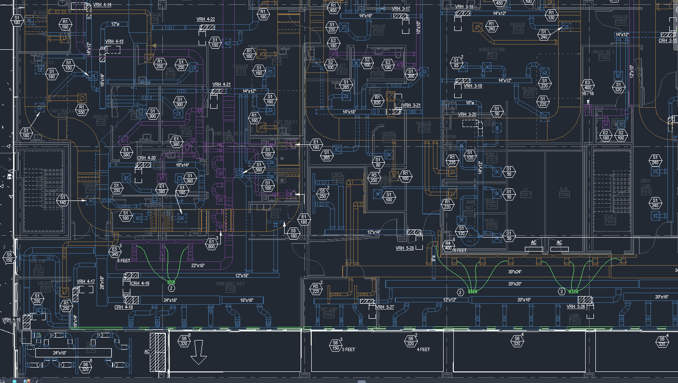
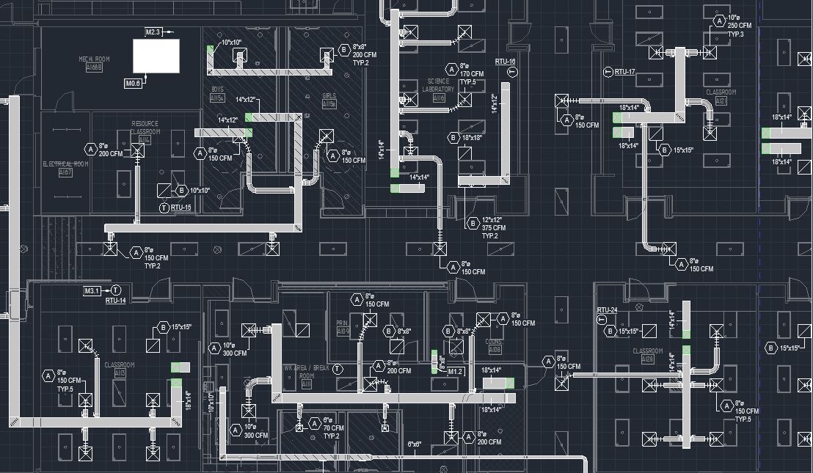
Determine system needs and complexity based on the building type and usage
Healthcare
Schools

Slide 2
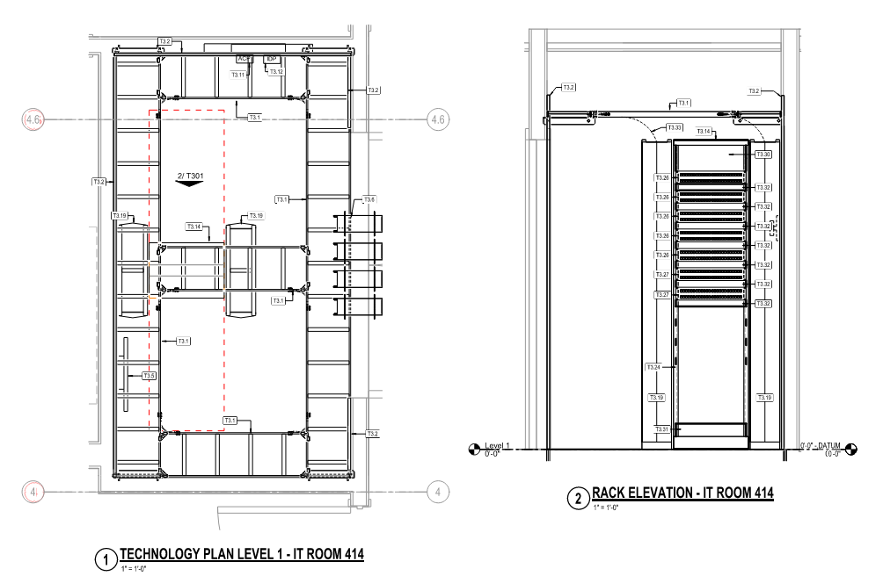
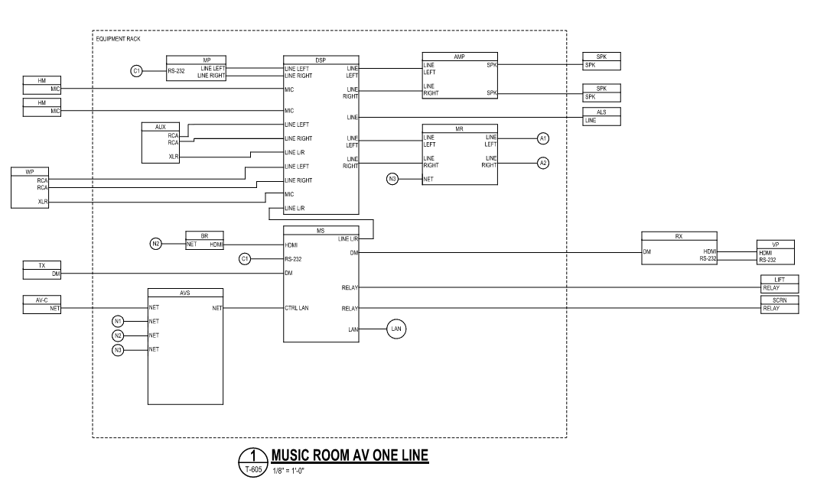
Layout an entire AV system from microphones, to amplifiers, to speakers
Layout Telecommunication Rooms and the equipment that goes inside

Slide 3
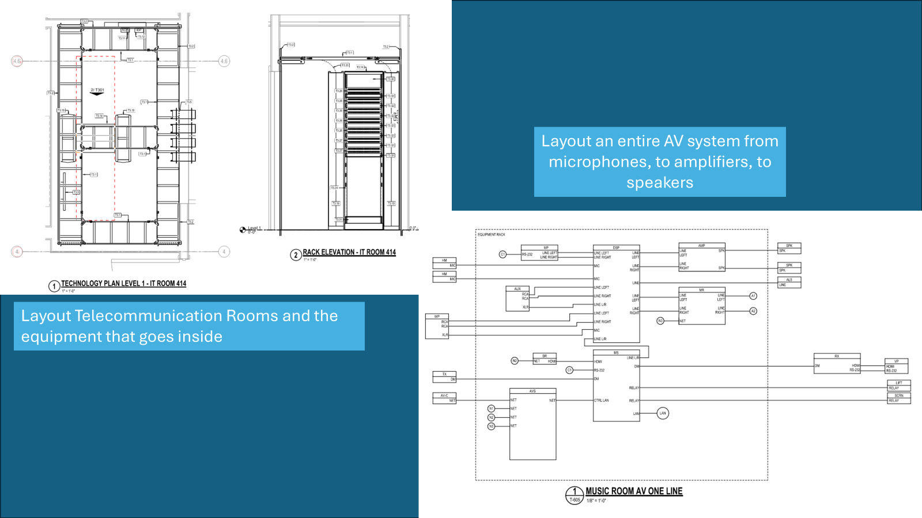

Slide 4
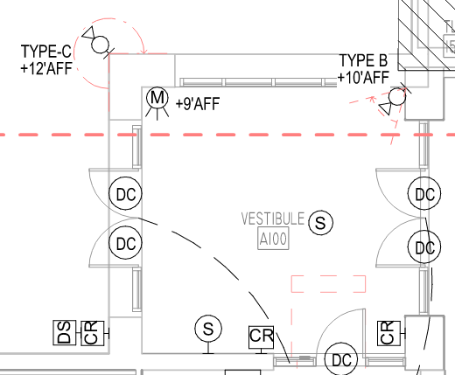
Layout Security systems that can efficiently and effectively protect schools, hospitals, and other building types from all kinds of threats

Slide 5

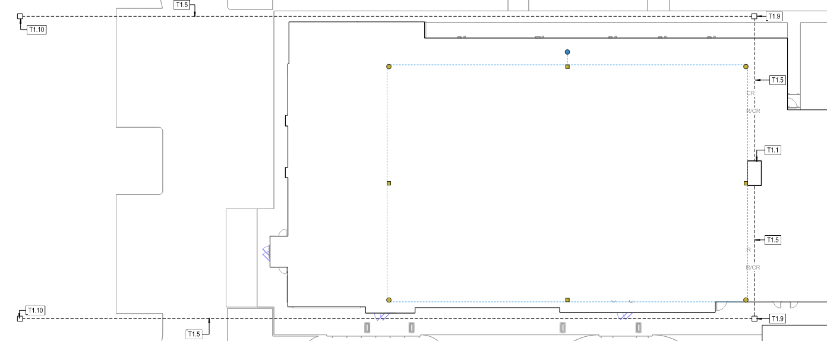
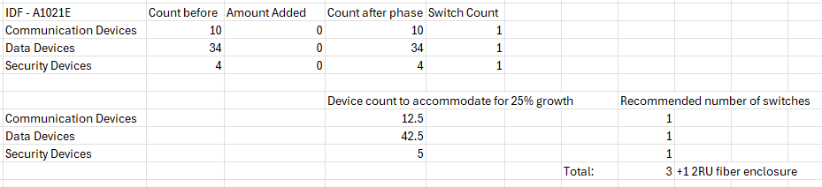
Redundant Service Pathway
Main
Service Pathway
Help to plan a data infrastructure that will be up and running no matter what while also being easily scalable for future technology

Slide 6
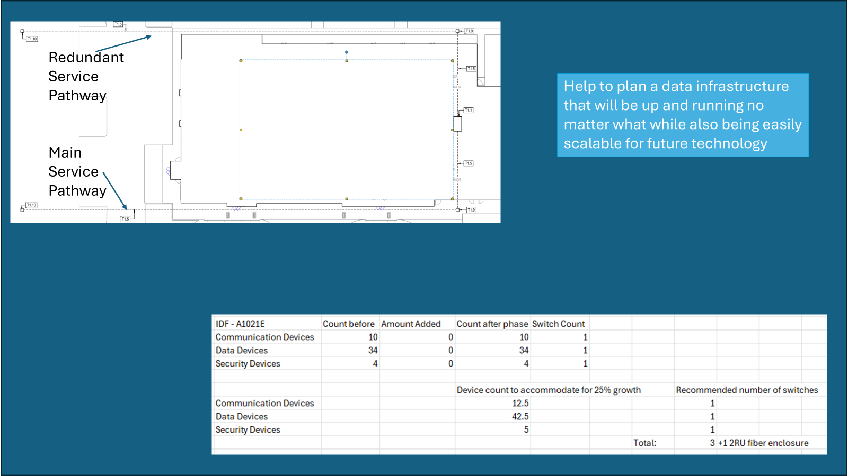

Slide 7
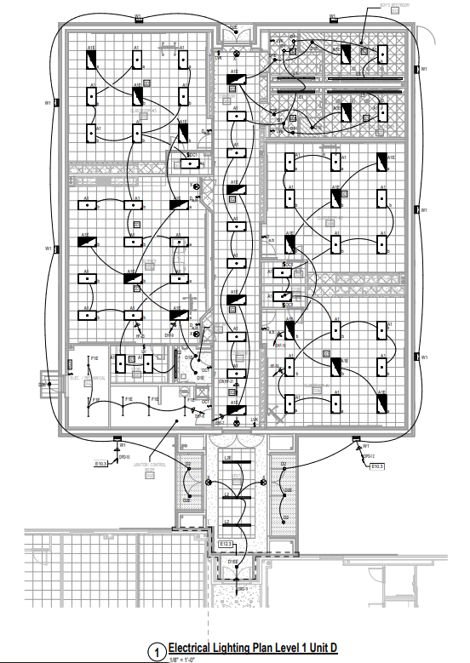
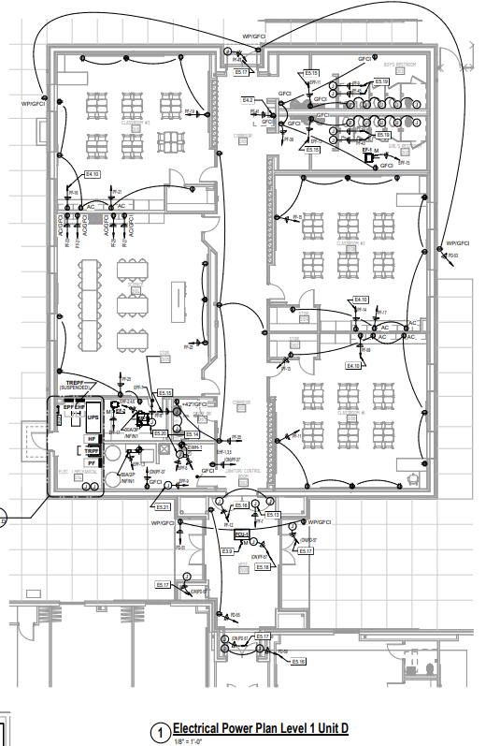
Create comprehensive lighting and power plans based on the building as well as the end users’ needs

Slide 8

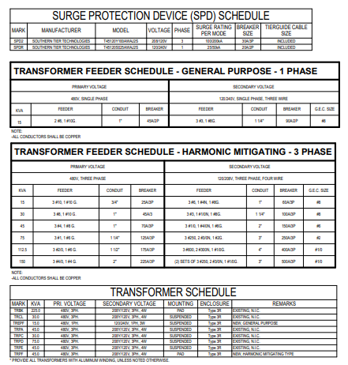
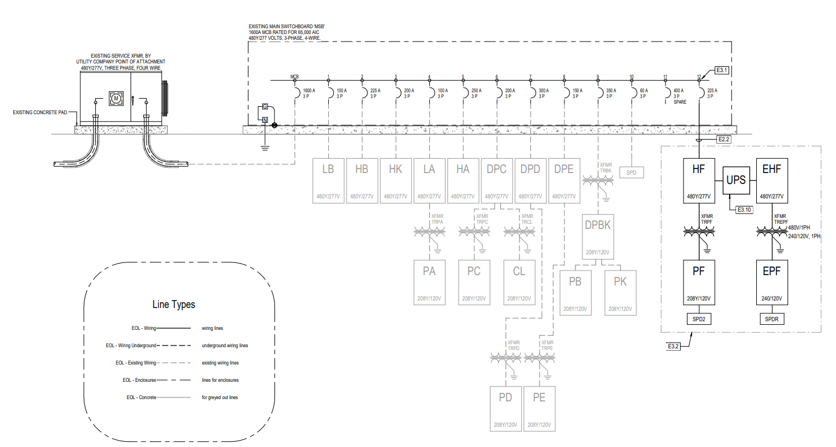
Create tables and diagrams that match up against your designs

Slide 9
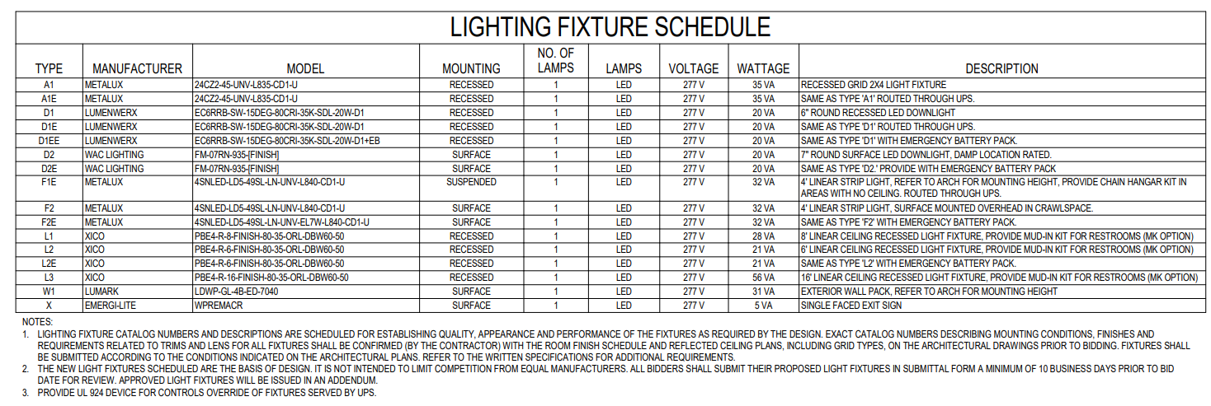
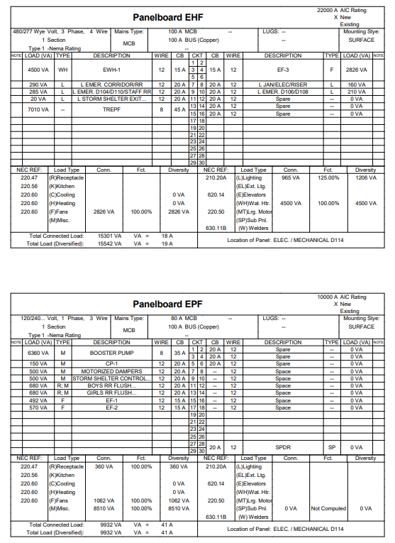
Use equipment data to balance electrical loads and lighting data

Slide 10

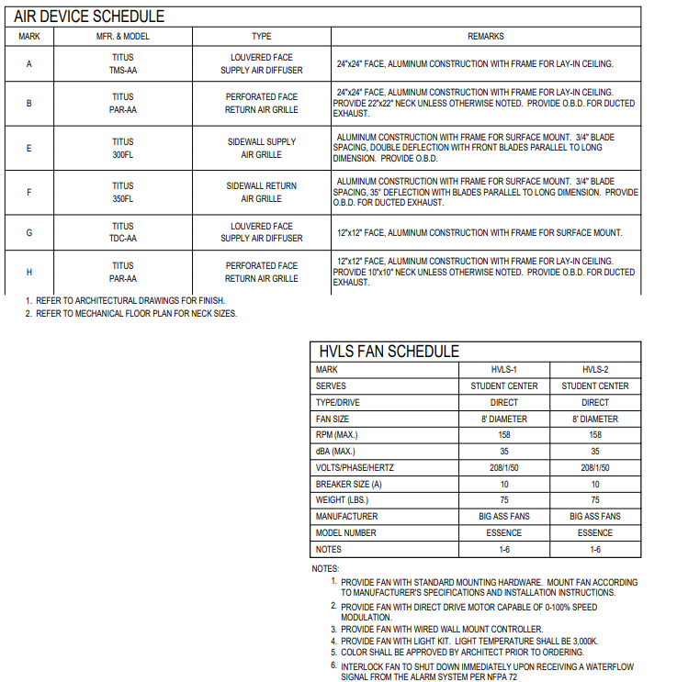
Size equipment based on a building’s needs

Slide 11
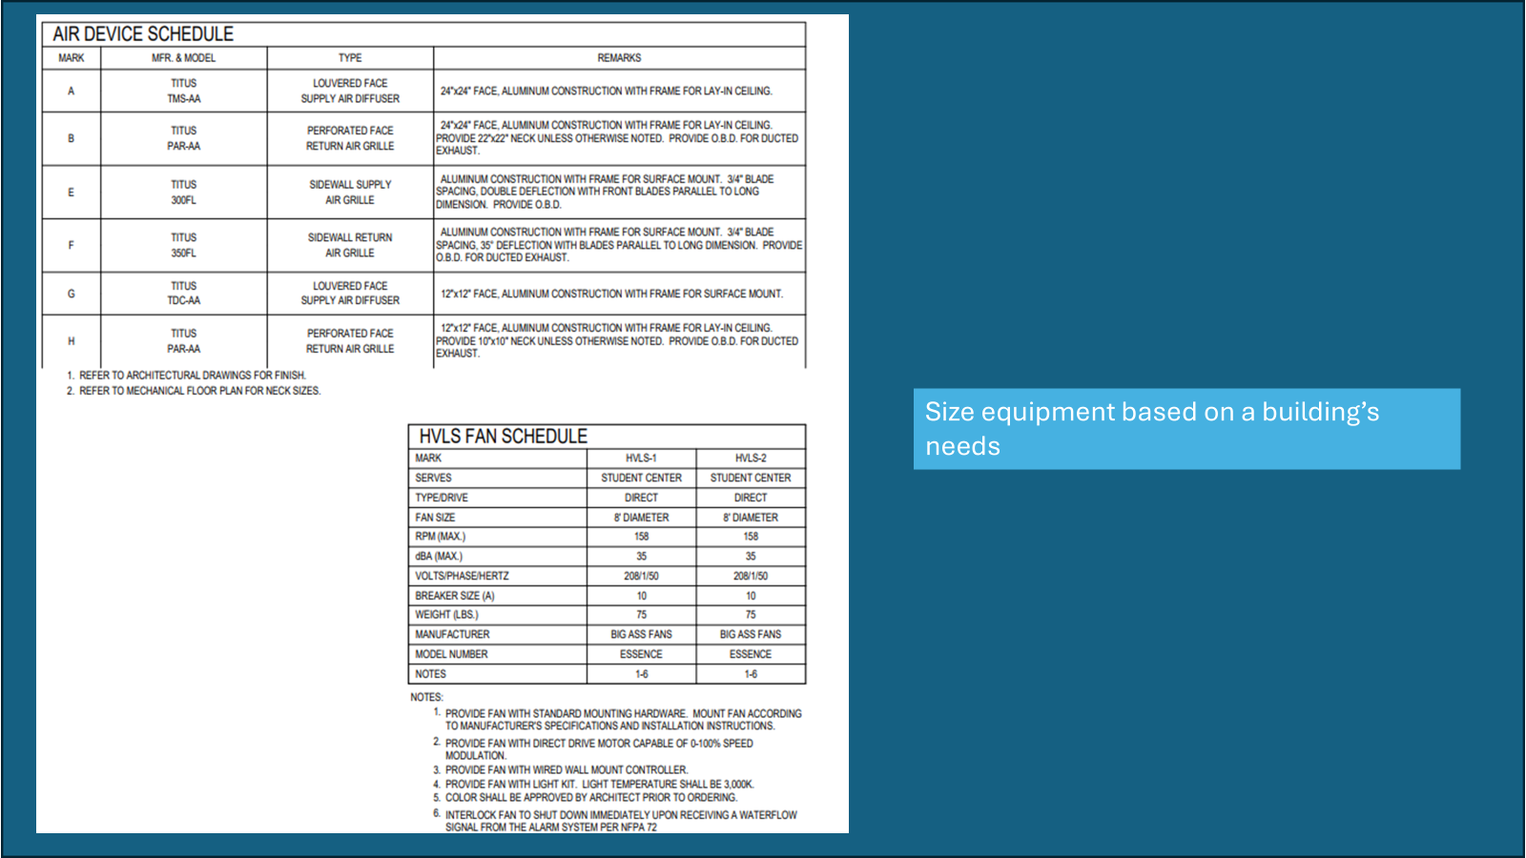

Slide 12
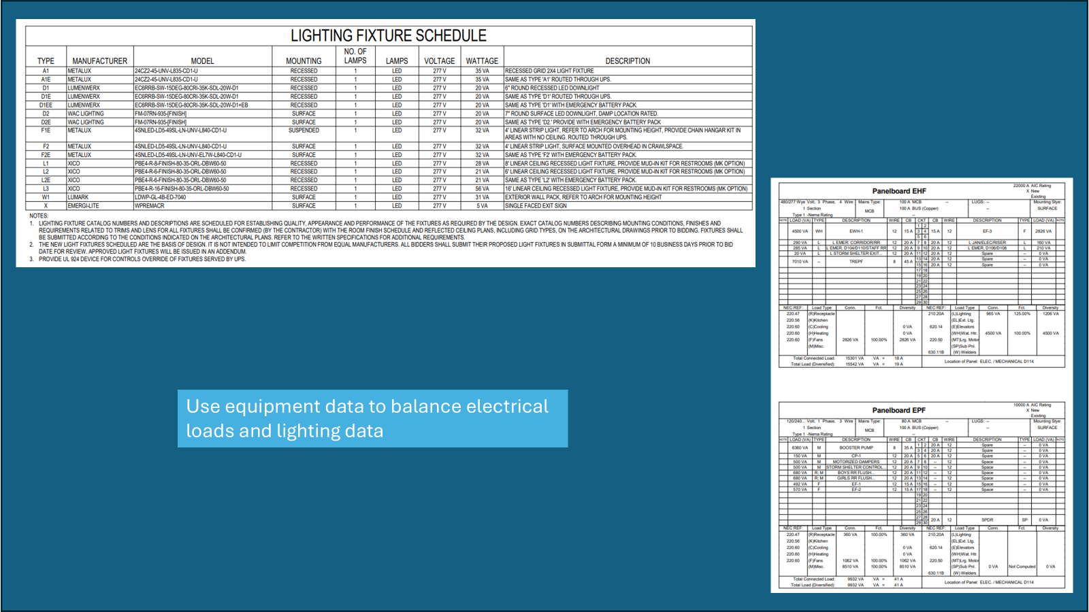

Slide 13
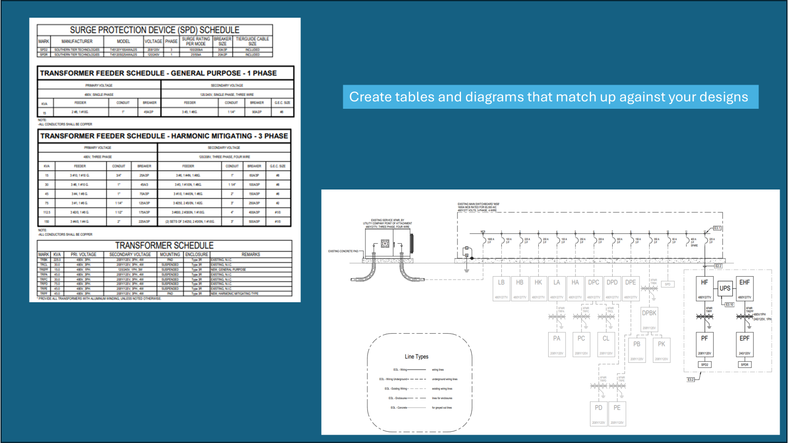

Slide 14
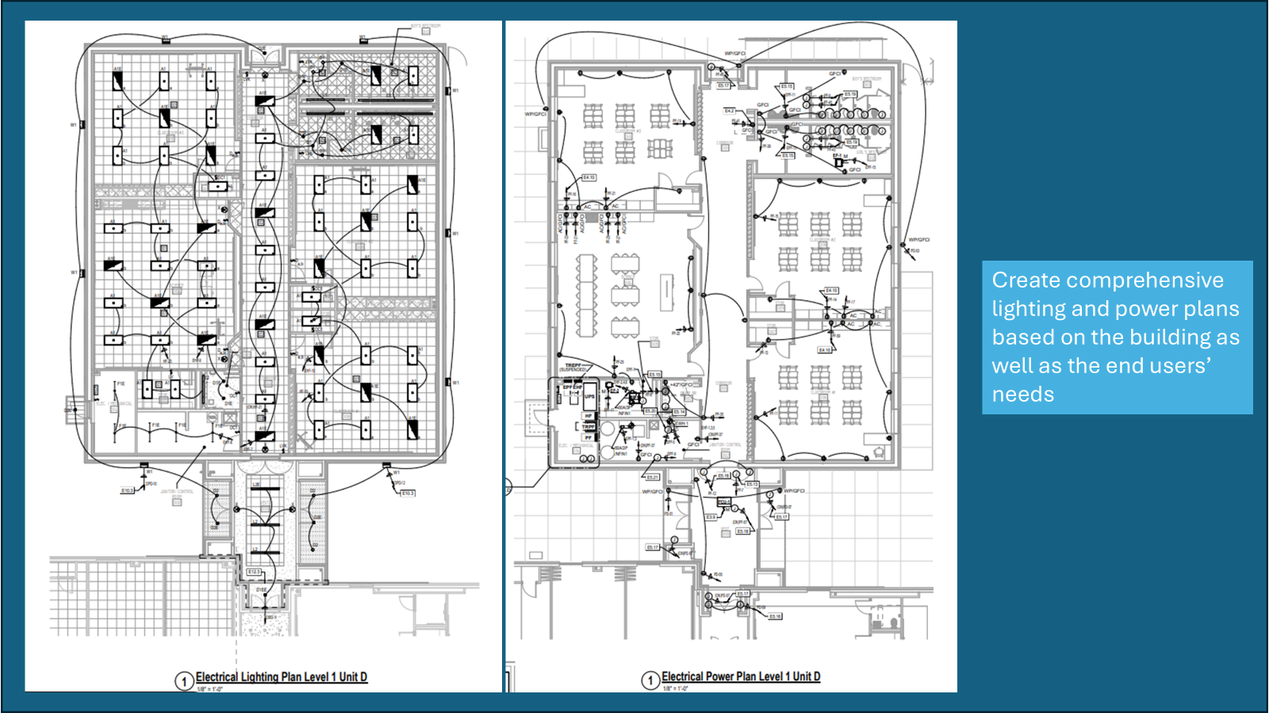

Slide 15
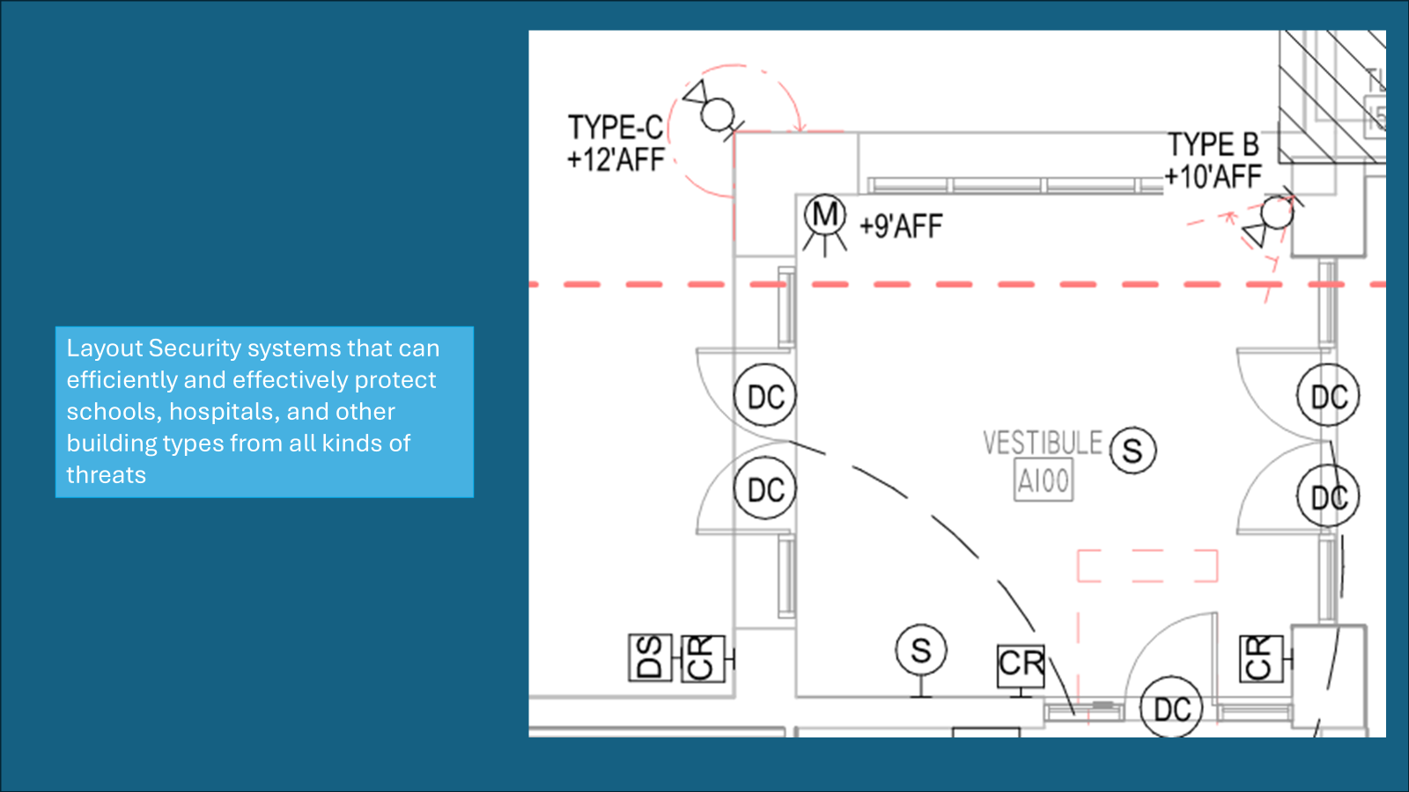

Slide 16
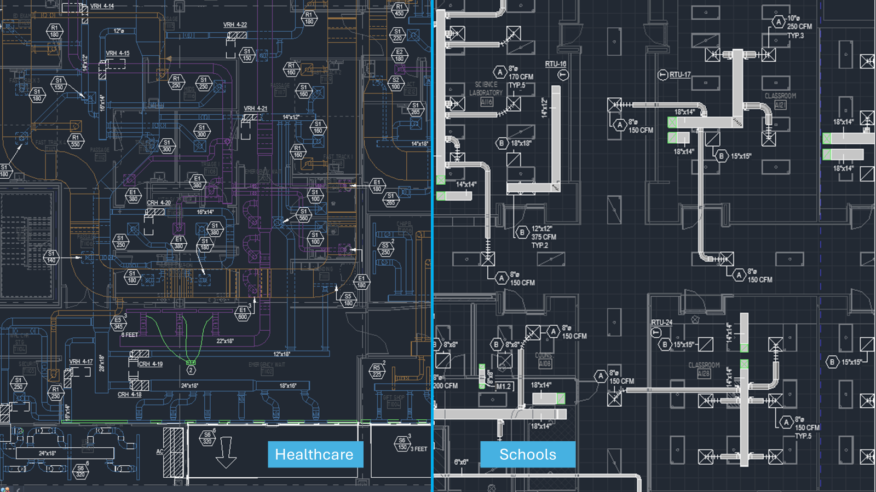
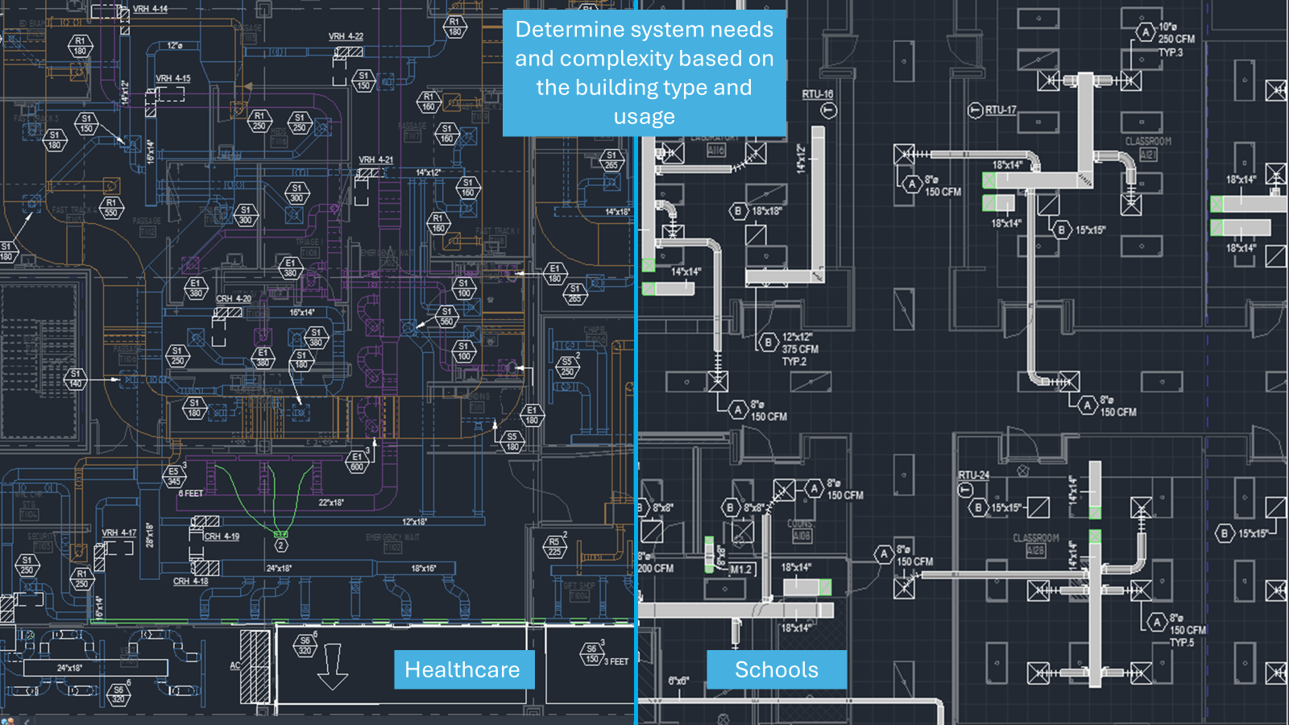

Slide 17


